Slide 1
Optimal Drones Recharging Scheduling Project
10/09/2020
Designed for Wireless Power Transfer and Data Collection
Qiuchen Qian

Slide 2
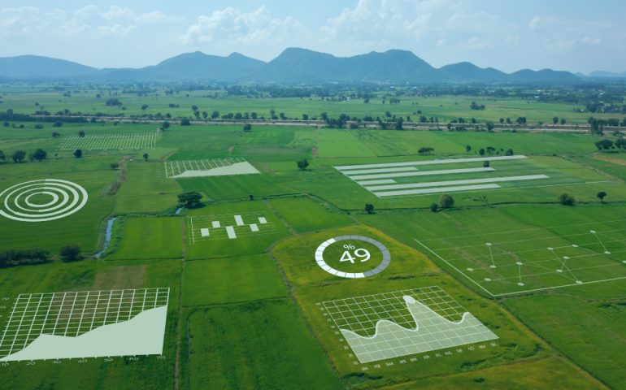
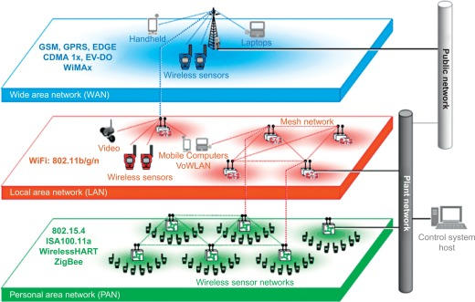
INTRODUCTION
Real applications of Wireless Sensor Network (WSN)
Poor power management
Smart Agriculture¹
Monitor Nuclear power plant ²
[1] RESEARCH for AGRICULTURE (2020, Jun. 3), Investing in our smart farming future [Online]. Available: https://researchforagriculture.com.au/2020/06/03/investing-in-our-smart-farming-future/
[2] P.L. Fuhr, “Wireless sensor networks for the monitoring and control of nuclear” in Woodhead Publishing Series in Electronic and Optical Materials, R. Budampati and S. Kolavennu, Woodhead Publishing, 2016, pp. 125-154.
1

Slide 3
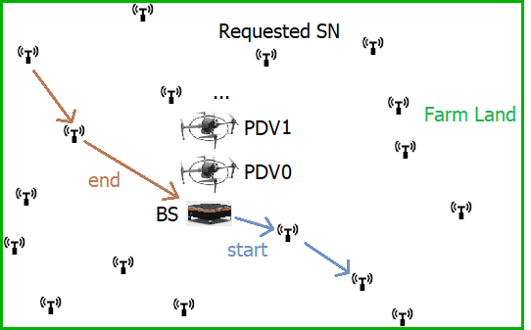
INTRODUCTION
A feasible solution: PDV-based WRSN
Challenge: Optimal Drones Recharging Scheduling (ODRS)
Drones Recharging Scheduling
2

Slide 4
INTRODUCTION
System Design:
Sensors and PDV selection
Environment simulation
GPS and UWB approaching
Two stage energy distribution system
Optimization Objectives:
Maximize total recharged energy
Minimize energy cost of all PDVs
3

Slide 5



OPTIMIZATION ALGORITHMS
Genetic Algorithm (GA)
Simulated Annealing Algorithm (SA)
Black Hole Algorithm (BH)
4

Slide 6
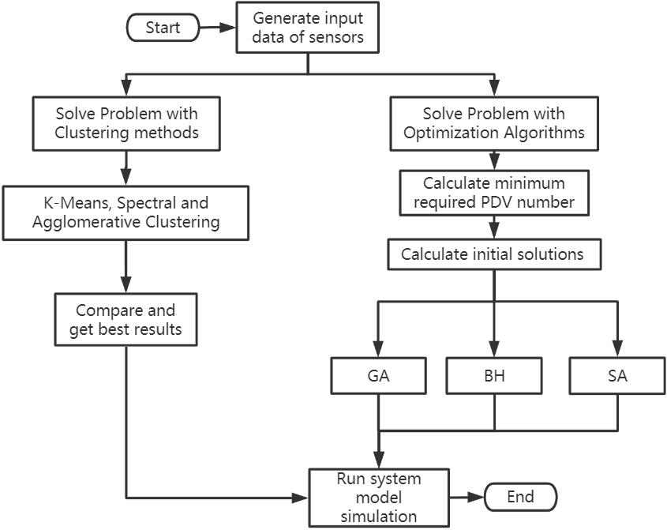
SYSTEM WORK FLOW
5

Slide 7
DEVELOPMENT STACK
Development tool:
- MSVC 2019 (ISO C++ 17)
- jupyter notebook (ipython 7.8.0)
Main libraries or frameworks:
- C++ Standard Template Library (STL)
- C++ Boost (file system)
- Python numpy & pandas (data processing)
- Python scikit-learn (clustering methods)
- Python Matplotlib (plotting)
6

Slide 8
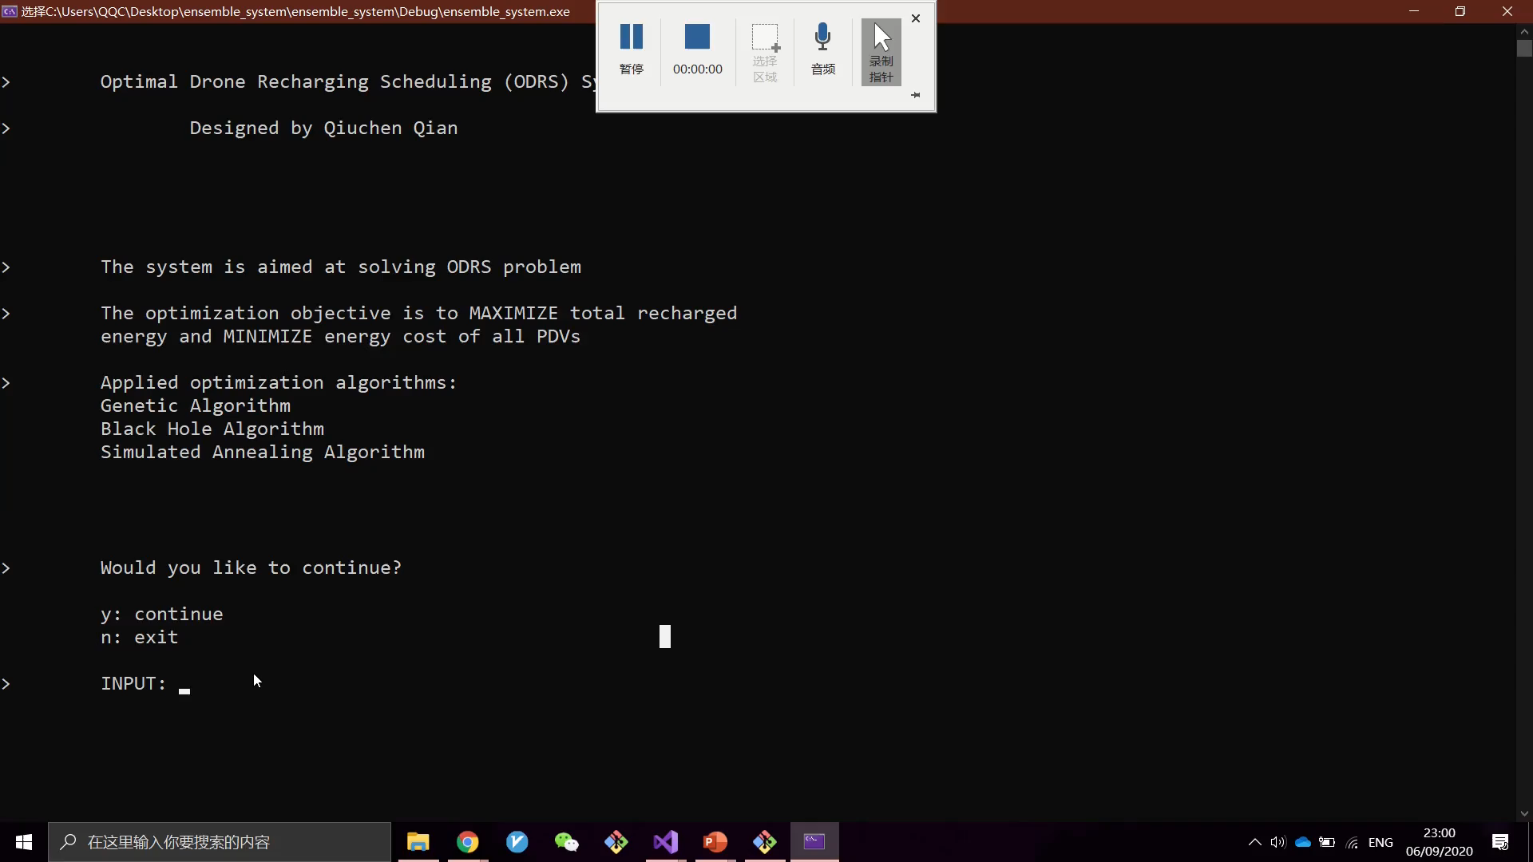
CODE DESCRIPTION & RESULTS
7

Slide 9
CODE DESCRIPTION & RESULTS
TEST RESULTS
8

Slide 10
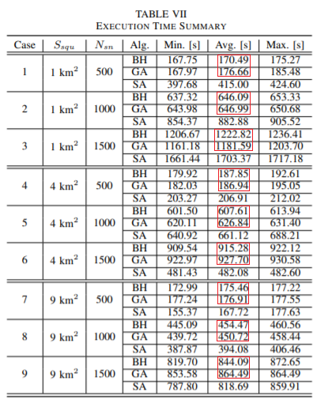
CONCLUSION
Achievements:
Designed a complete system
Designed parallel scheduling¹
Proposed an evaluation approach
Modified optimization algorithms
[1] A. Y. S. Pandiyan, M. E. Kiziroglou, D. E. Boyle, S. W. Wright, and E. M. Yeatman, "Optimal energy management of two stage energy distribution systems using clustering algorithm," in \textit{IEEE POWERMEMS}, 2019.
9
Notes:
Limitations:
Simulation result can be better
Theoretical system model
Not integrated all functions into the system yet

Slide 11
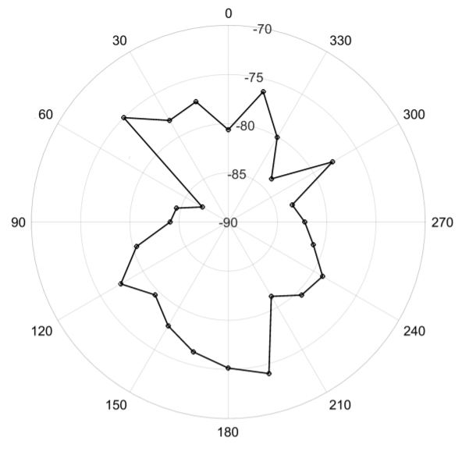
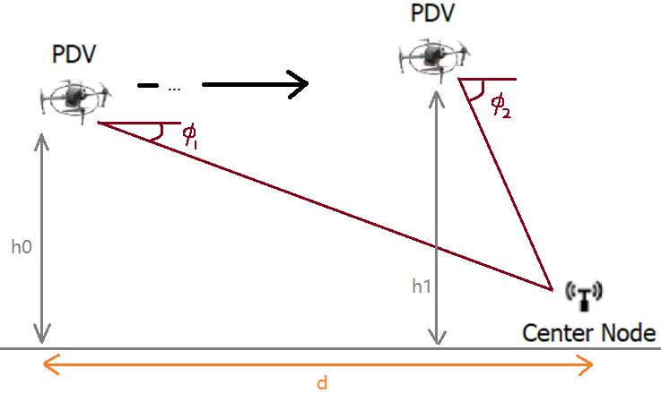
FUTURE WORK
Existing limitations…
3D space:
Consider PDV flight height
Consider effect of angle to IPT
Weather:
Wind effect to normal flight (flight speed, energy cost)
When performing IPT… (Re-calculate angle)
Battery:
Hybrid system of super capacitor and Li-ion battery
Angle effect
Received Signal Strength Indicator (RSSI) value [6]
[1] Y. Qin, D. Boyle, E. Yeatman, “Efficient and Reliable Aerial Communication with Wireless Sensors,” in IEEE Internet of Things Journal, Vol. 6, Issue 5, 2019.
10

Slide 12
Q & A
Thank you for watching !
12

Slide 13
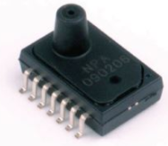
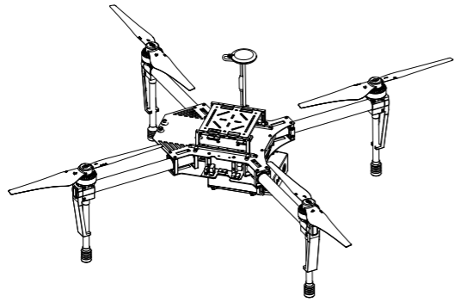
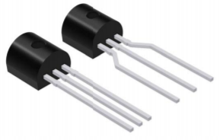
SENSORS & PDV SELECTION
Pressure Sensor:
- NPA300
Temperature Sensor:
- LMT84
Power Delivery Vehicle:
- DJI Matrice 100 (M100)
NPA300¹
DJI M100³
LMT84²
Back
[1] Amphenol, Advanced, and Sensors. (11-Nov-2019). Available: https://www.amphenol-sensors.com/en/novasensor/pressure-sensors/3161-npa-series
[2] LMT84 1.5-V, SC70/TO-92/TO-92S, Analog Temperature Sensors Data Sheet, EATON, Nov. 2016.
[3] DJI Matrice 100 User Manual, Mar 2016. [Online]. Available: https://www.dji.com/uk/matrice100/info
3-1

Slide 14
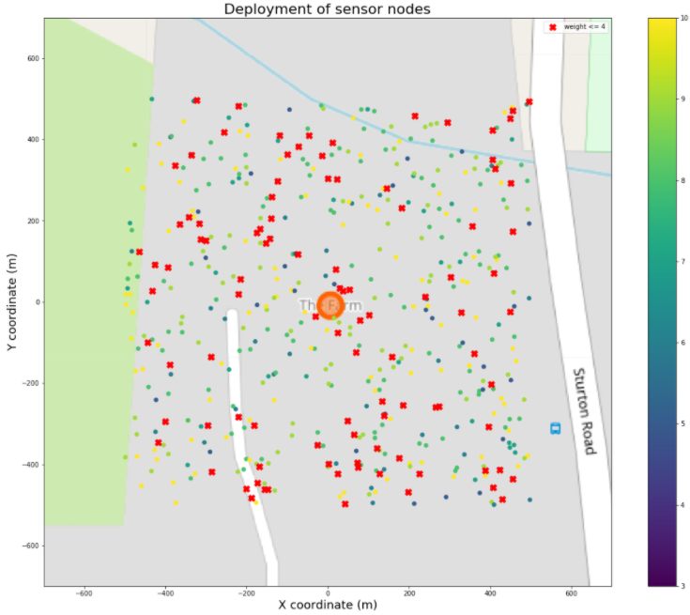
ENVIRONMENT SIMULATION
Simplified system model:
2D square
Single Base Station (center)
Randomly deployed sensors
No external interference (i.e. weather, obstacles, etc.)
An example of SN deployment
Back
3-2

Slide 15
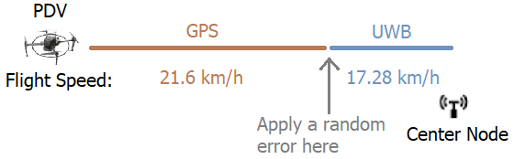
GPS & UWB APPROACHING
Different PDV approach strategies
Back
3-3

Slide 16
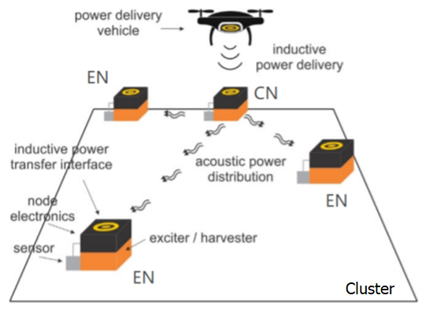
TWO STAGE ENERGY DISTRIBUTION
Inductive Power Transfer (IPT) & Acoustic Power Transfer (APT)
Two stage energy distribution system¹
Back
[1] D. E. Boyle, S. W. Wright, M. E. Kiziroglou, A. Y. Pandiyan, and E. M. Yeatman, “Inductive power delivery with acoustic distribution to wireless sensors,” in IEEE PELS Workshop on Emerging Technologies: Wireless Power Transfer (WoW), 2019, pp. 202–204.
3-4

Slide 17
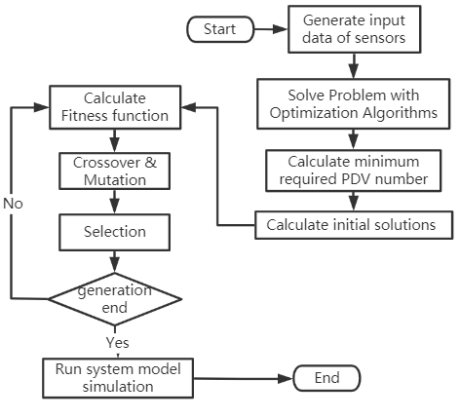
GENETIC ALGORITHM
GA work flow
Back
4-1

Slide 18
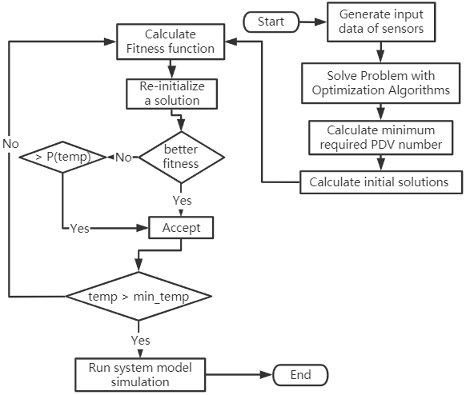
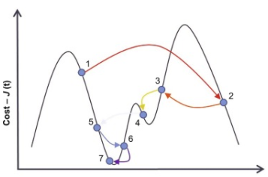
SIMULATED ANNEALING ALGORITHM
SA work flow
SA example¹
Back
[1] Clara Marina Martínez, Dongpu Cao, in Ihorizon-Enabled Energy Management for Electrified Vehicles, 2019.
4-2

Slide 19
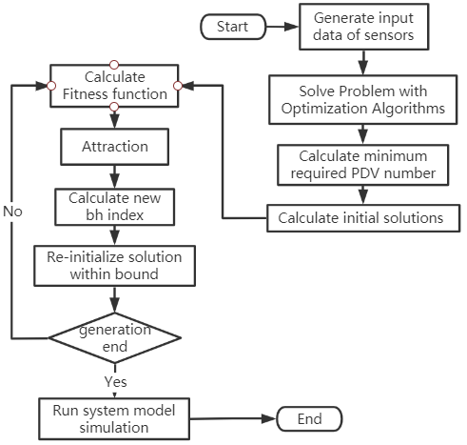
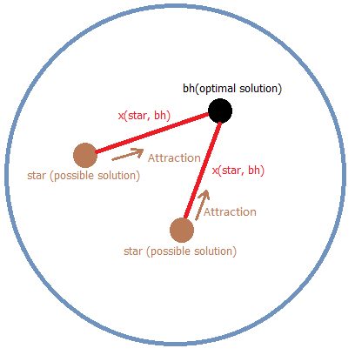
BLACK HOLE ALGORITHM
BH work flow
BH attraction
Back
4-3

Slide 20
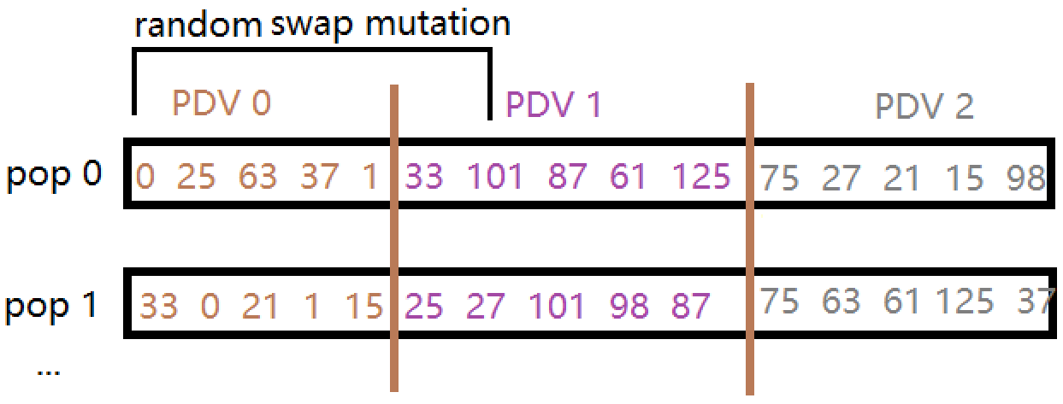
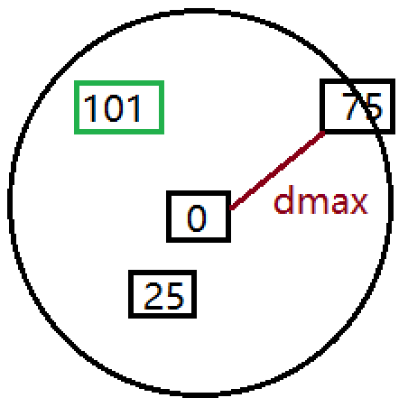
GENETIC ALGORITHM DETAILS
GA sample

